Slide 1
Command and Memento
CS350/SE310, Fall 2015

Slide 2
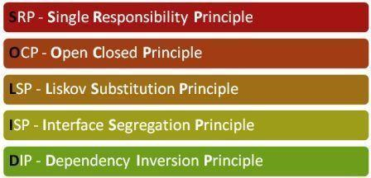
SOLID
Goal: highly maintainable + highly re-usable code

Slide 3
Let’s continue with Behavioral Patterns

Slide 4
The Command Pattern encapsulates a request as an object, thereby letting you parameterize clients with different requests, queue or log requests, and support undoable operations

Slide 5
Command Pattern

Slide 6
Undoable Command

Slide 7

Bullet Points
The Command Pattern decouples an object, making a request from the one that knows how to perform it.
A Command object is at the center of this decoupling and encapsulates a receiver with an action
An invoker makes a request of a Command object by calling its execute() method, which invokes those actions on the receivers

Slide 8
Bullet Points
Invokers can be parameterized with Commands, even dynamically at runtime
Commands may support undo by implementing an undo method that restores the object to its previous state before the execute() method was last called.

Slide 9
What if I need to remember where I am in the game?

Slide 10
Memento Pattern

Slide 11
Memento Benefits
Keeping the saved state external from the key object helps to maintain cohesion
Keeps the key object’s data encapsulated
Provides easy-to-implement recovery capability

Slide 12
Memento Uses and Drawbacks
The Memento is used to save state
A drawback to using Memento is that saving and restoring state can be time consuming
In java systems, consider using Serialization to save a system’s state

